Slide 1
PRICE-BASED RESOURCE ALLOCATION FOR EDGE COMPUTING: A MARKET EQUILIBRIUM APPROACH

Slide 2


Slide 3
INTRODUCTION:
The emerging edge computing paradigm promises to deliver superior user experience and enable a wide range of Internet of Things (IoT) applications.
In this paper, we propose a new market-based framework for efficiently multiple competing services at the network edge.

Slide 4
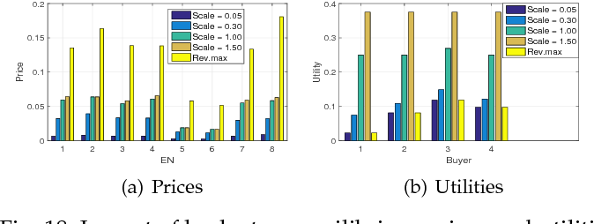
When the utility of a service is defined as the maximum revenue that the service can achieve from its resource allotment, the equilibrium can be computed centrally by solving the Eisenberg-Gale (EG) convex program.

Slide 5
When each service aims to maximize its net profit (i.e., revenue minus cost) instead of the revenue, we derive a novel convex optimization problem and rigorously prove that its solution is exactly an ME.
Extensive numerical results are presented to validate the effectiveness of the proposed techniques.

Slide 6
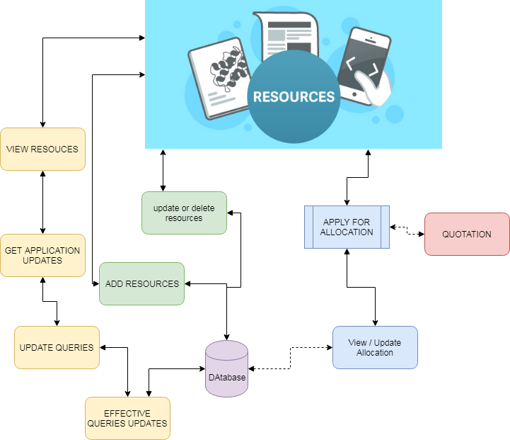
ARCHITECTURE:

Slide 7
EXISTING SYSTEM:
In particular, we study how to allocate resources from multiple ENs to multiple services in a fair and efficient way.
We exploit the General Equilibrium, a Nobel prize-winning theory, to construct an efficient market-based resource allocation framework.
Although this concept was proposed more than 100 years ago, only until 1954, the existence of an ME was proved under mild conditions in the seminal work of Arrow and Debreu.

Slide 8
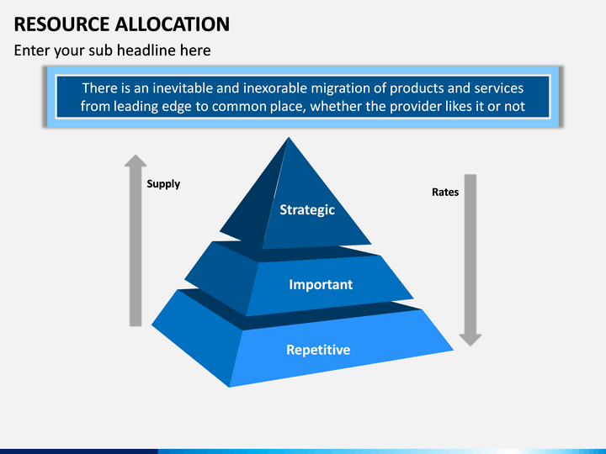

Slide 9
PROPOSED SYSTEM:
Our proposed models are inspired by the Fisher market which is a special case of the exchange market model in the General Equilibrium theory.
Every agent comes to the market with an initial endowment of money only and wants to buy goods available in the market.
More importantly, we systematically devise a new and simple convex program to capture the market in which money has intrinsic value to the buyers, which is beyond the scope of the classical Fisher market model.

Slide 10
Different from the existing works on cloud economics and resource allocation in general, our design objective is to find a fair and efficient way to allocate resources from multiple nodes (e.g., ENs) to budget-constrained agents (i.e., services), which makes every agent happy with her resource allotment and ensures high edge resource utilization.
The proposed model also captures practical aspects, for example, a service request can be served at different ENs and service demands can be defined flexibly rather than fixed bundles as in auction models.

Slide 11
ALGORITHM:
DECISION TREE ALGORITHM:
Decision tree is the most powerful and popular tool for classification and prediction.
A tree can be “learned” by splitting the source set into subsets based on an attribute value test. This process is repeated on each derived subset in a recursive manner called recursive partitioning.
The recursion is completed when the subset at a node all has the same value of the target variable, or when splitting no longer adds value to the predictions.

Slide 12



MODULES:
ADD RESOURCE:
The resources have been uploading in database in order to view for users.

Slide 13
2. ALLOCATE RESOURCE :
The received applications are viewed by admin.
Admin then, find the available space and view application and based on that, algorithm applied to sort the best user to be allocated or the allocation space will be measured according to the quotation of user had submitted.
The allocated resource can be utilized by user and admin need to intimate the user that how much resource have been allocated.

Slide 14
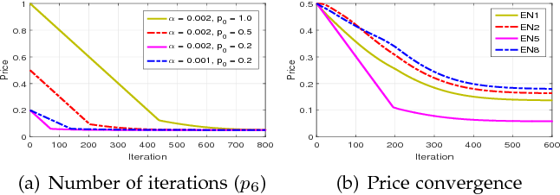
3. USER QUERIES:
Users can have queries about the process.
This part of project is dedicated to make and get response for queries that are needed to answerable.
4. GRAPH ANALYSIS:
Graph analysis is the part where admin can knows the statistics about process of details.

Slide 15
CONCLUSION:
In this work, we consider the resource allocation for an EC system which consists geographically distributed heterogeneous ENs with different configurations and a collection of services with different desires and buying power.

